Slide 1

Wallstreetbets reddit analysis
Jen Hilibrand

Slide 2
warning!
Reddit comments are left in their original form

Slide 3
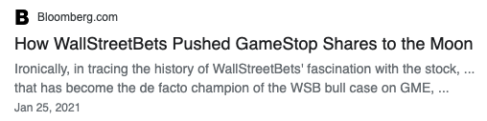
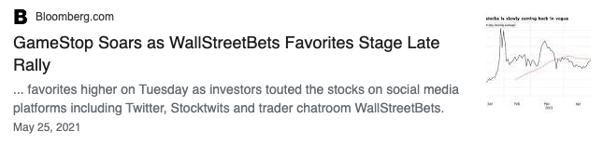
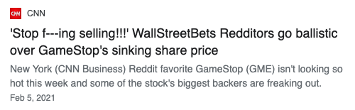
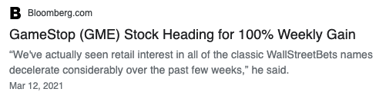
GME closing price

Slide 4
Context
32.5 bn
Max daily volume
gme
+2,941%
at peak
Temporarily was the highest valued company in the Russell 2000
32 BN
peak
Market cap added
13 bn
Max daily volume
AMC
+9,480%
at peak
Added equivalent of Cambodia’s GDP
23 BN
peak
Market cap added

Slide 5
Key Concepts
Short Selling
Squeezes
Market participants
Function, Spreads, Capital Requirements
Short Squeeze, Gamma Squeeze
Retail, Robinhood, HFs, Companies themselves

Slide 6



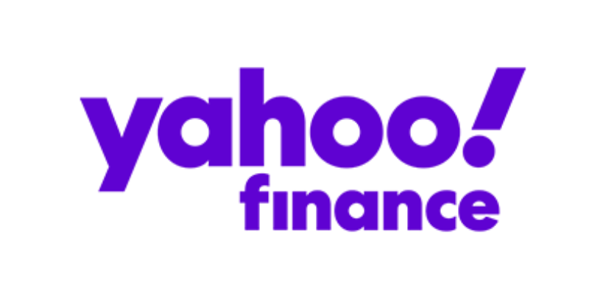



Workflow
Reddit
Python
NLTK
YFinance
Scikit learn
Tableau
Streamlit

Slide 7
Top 100 posts per month for H1 2021
SOURCE
60k comments
~1.4mm words ~40k unique words
DATA
LSA and NMF
Vader for sentiment analysis
ANALYSIS

Slide 8
topics

Slide 9
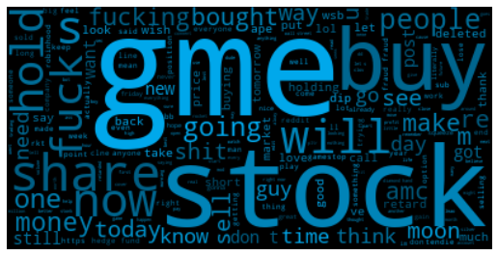

Slide 10
Topic 1: GME, AMC, Fanaticism
Key words:
gme, like, just, stock, people, shares, don, buy, price, going, money, make, market, think, short, sell, want, buying, fucking, know, ve, funds, fuck, time, hedge, holding
“GME AND AMC TO THE MOON 🚀🚀🌚”
“💎🙌💎🙌💎🙌💎🙌📈📈📈📈📈📈”
“It’s gme or nothing”
“Buy more AMC/GME, hold until 🚀🚀🚀”
“BUY THE DIP AND HOLD $GME and $AMC to the moon!!!!”
“I’m buying more amc Gme and bb 🚀🚀🚀🚀🚀💎🙏💎🙏💎🙏💎🙏💎🚀🚀🚀🚀🚀”
“AMC and GME 🚀🚀🚀🚀🚀🌚🖐🦍🎥🍿💎🍗🦍🖐🚀🚀🚀🚀🚀🚀”
AMC and GME 🖐🍿🖐💎🖐🚀🖐🦍🖐🍿🖐🌚🍿
GME is looking like a bargain right now. Buy buy buy buy buy 🚀🚀🚀🚀
Keep pushing on $$AMC $$GME and nothing else, 📈📈📈
“#GME TO $1000, GET IN, GET IN!!”

Slide 11
Topic 2: Holding
Key words:
gme, hold, buy, bb, holding, moon, rkt, fucking, squeeze, nbsp, nok, today, line, let, silver, stocks, apes, financial, tomorrow, fuck, hands, wsb, edit, account, strong
“Just bought 4 more shares 🚀”
“my savings is GONE. BUT IM HOLDING ON. 🚀🚀🚀🚀🚀🚀🚀🚀”
Holding 🖐💎🖐💎
“I'm still holding. To the moon🚀 all or nothing”
“I bought one at $90 just so I can be a part of the movement :)”
“Just bought 10 shares. Holding.”
Just got my first 5 shares, never letting go🌝🚀🚀🚀
“I'm still in, bought my first shares on Thursday, more on Monday, holding :)”

Slide 12
Topic 3: “Us vs. hedge funds”; underdogs; squeeze the shorts
Key words:
cover, days, short, friday, sell, melvin, day, capital, shorts, shares, fucking, squeeze, covering, week, ass, dildos, gonna, ratio, volume, need, million, shorted, number, position, starts
“WE ARE THE LITTLE GUY.”
“This means fucking war. WE LIKE THE STOCK.”
“Another Gamma Squeeze still coming on Friday. SHORTS HAVE NOT CLOSED!”
“Naked to $5 a share. Fuck wallstreet. WE like the stock. We the people, Its our money.”
MELVIN HAVE UNLIMITED LOSS POTENTIAL. ???% SHORT INTEREST ON NAKED SHORTS THAT DONT EXPIRE ON GME. THEY CANNOT ESCAPE IF NO GME SHARES SELL.
“If you don’t think Melvin and Shitron and the funds that propped them up aren’t calling in favors like this right now you’re living in fantasy land.”
“HOLDING THEM ACCOUNTABLE. HOLDING UNTIL BAILOUT. WHOS TOO BIG TO FAIL NOW?”

Slide 13
Topic 4: anti-establishment, censorship, conspiracy
Key words:
fraud, robinhood, sec, server, discord, media, social, important, posts, bloomberg, markets, hunts, drove, articles, integrity, gamestop, wallstreet, financial, news, securities, wallstreetbets, hateful, warnings, evidence, jail
“This kind of manipulative technique just solidified my resolve to double down on $GME. It was a good interview that drew attention to the faults of the hedge funds investment practices. He eloquently deflected any blame for the retail investor and made CNBC look bad. The video has since been deleted due to copyright and comments have been disabled. $GMC 🚀🚀🚀💎💎🙌”
“Don’t trust the mods - there are other subreddits that allow good discussion on specific stocks like AMC AND GME. Which arnt being taken down from the top - THINGS I SAW WERE DELETED INCLUDED GME YOLOS OF 100k or more - DONATIONS TO FOODBANKS WITH WINNINGS ON GME. This seems to be OG WSB Creator 2.0 they’re 100% shilling. RKT has a huge amount of Longs OWNED BY CITADEL.”

Slide 14
Topic 5: Hype, Teamwork, Enthusiasm
Key words:
amc, bb, buy, nok, moon, bought, today, holding, tomorrow, stocks, let, movies, nbsp, hedge, security, got, wish, time, br, shares, war, trading, clov, low, market
THIS IS THE WAY! 🚀 🚀 🚀 🚀
“**🚀🚀💎🙌🏽💎🙌🏽**“
“This is the way.”
“🚀🚀🚀🚀🚀 all the way to the fucking moon!!!!! Let's go!!!.”
“This is the way fellow 🦍 💎🙌🚀🚀🚀🌝”
“TO THE MOON WE GO TOMORROW AMC ALL THE WAY 🚀🌚“
“ALL THE WAY BOYS🚀🚀🚀“
“I just bought 4 shares in support”
“This is the way. Hold with you brother!“

Slide 15
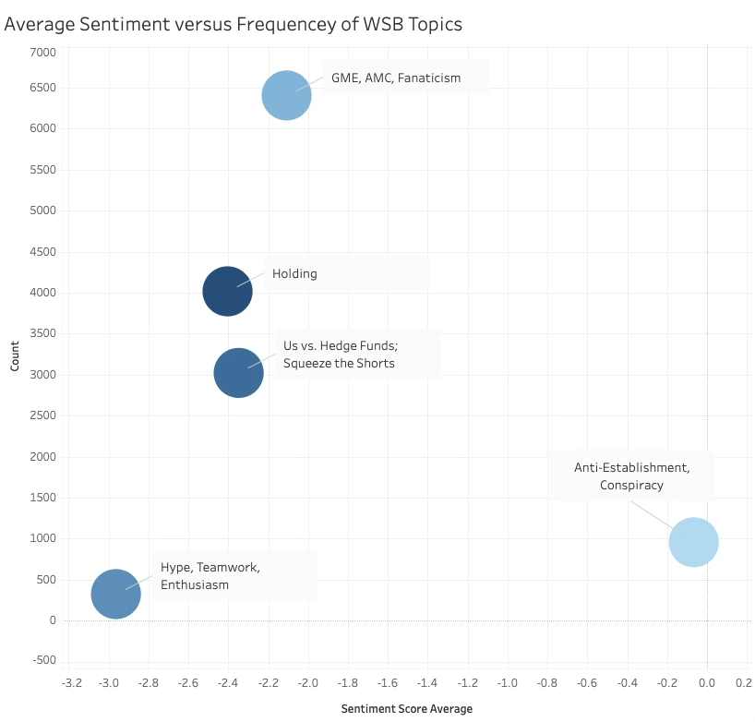

Slide 16
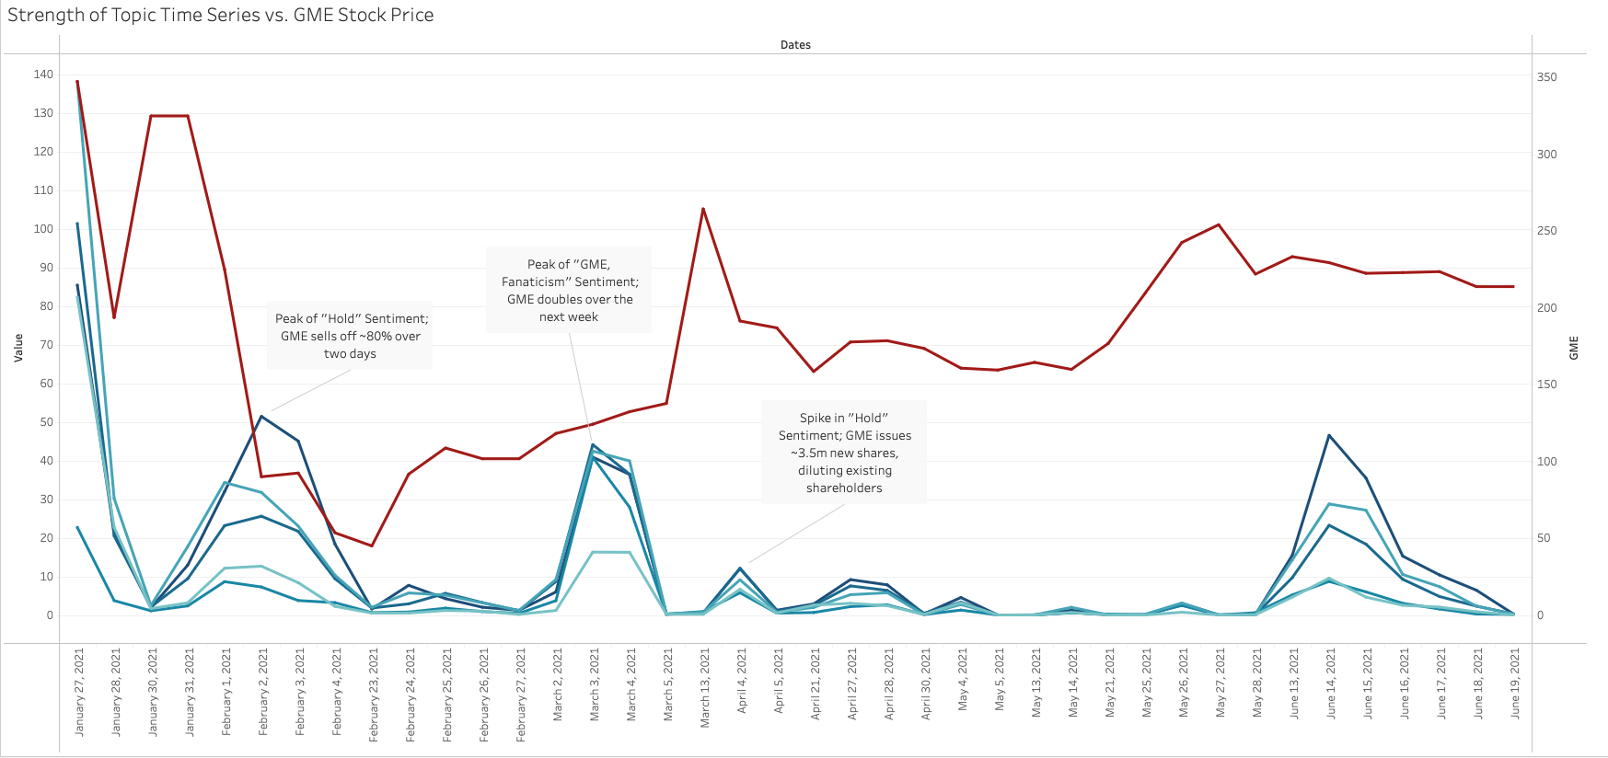

Slide 17
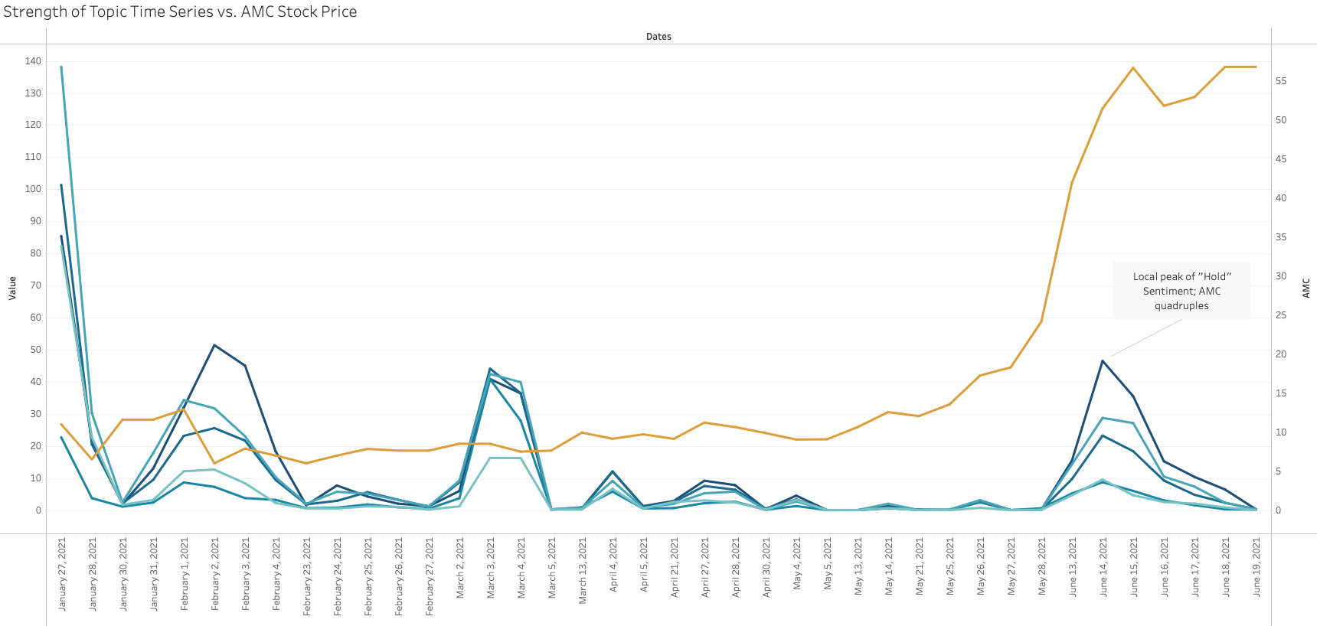

Slide 19
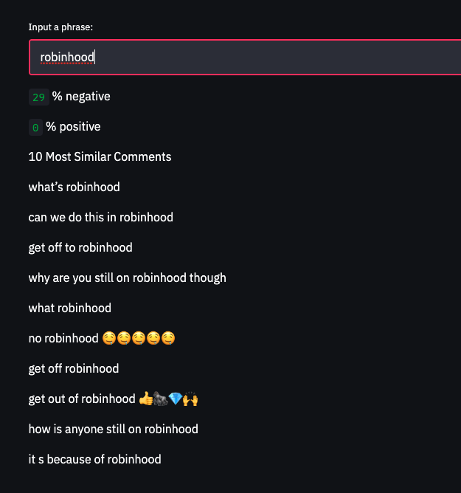
Similar Peers and Sentiment

Slide 20
Future work
More granular analysis that overlays DoD sentiment changes and stock price moves

Slide 21
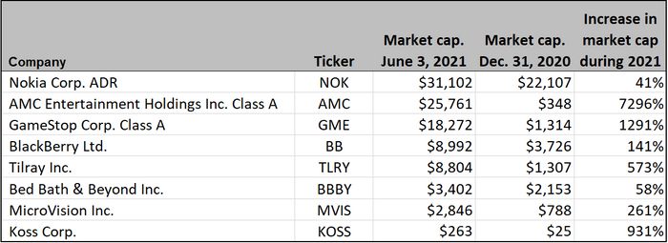
appendix
Meme stock returns
factset

